Slide 1
بِسْمِ اللهِ الرَّحْمٰنِ الرَّحِيْمِ

Slide 2

Natural Language Processing (NLP)
Lecture 05 – Data and Annotations
Instructor:
Dr. Jawad Shafi

Slide 3
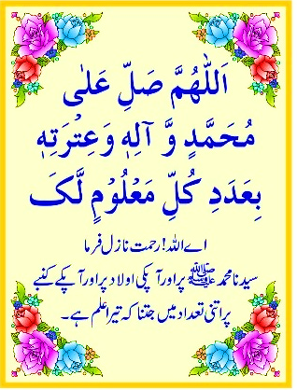
Dua – Take Help from Allah Before Starting Any Task
اللَّهُمَّ خِرْ لِيْ وَاخْتَرْ لِي
سُبْحَانَكَ لَا عِلْمَ لَنَا إِلَّا مَا عَلَّمْتَنَا ۖ
إِنَّكَ أَنْتَ الْعَلِيمُ الْحَكِيمُ
رَبِّ اشْرَحْ لِي صَدْرِي
وَيَسِّرْ لِي اَمْرِي
وَاحْلُلْ عُقْدَةً مِنْ لِسَانِي
يَفْقَهُوا قَوْلِي

Slide 4
Main Steps for Data Annotations

Slide 5
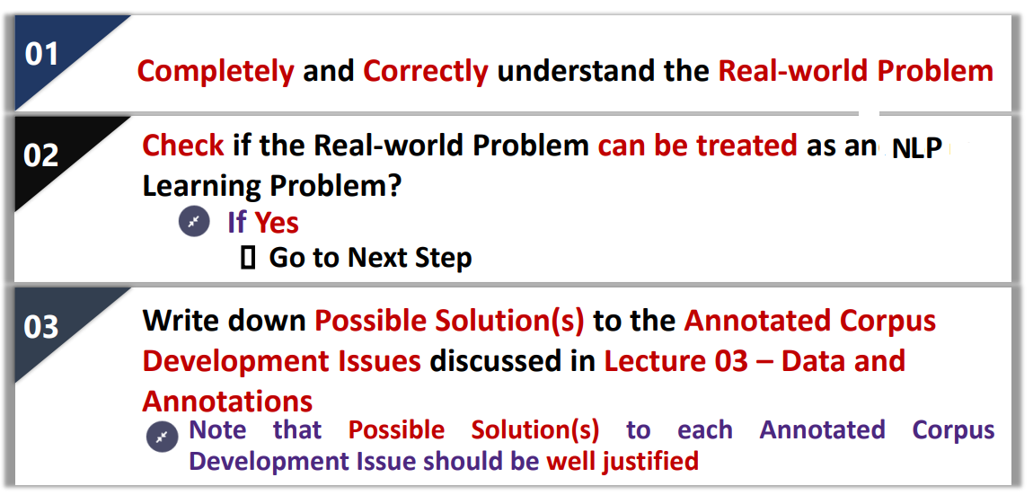
Main Steps for Data Annotation
Myth
Outcome

Slide 6
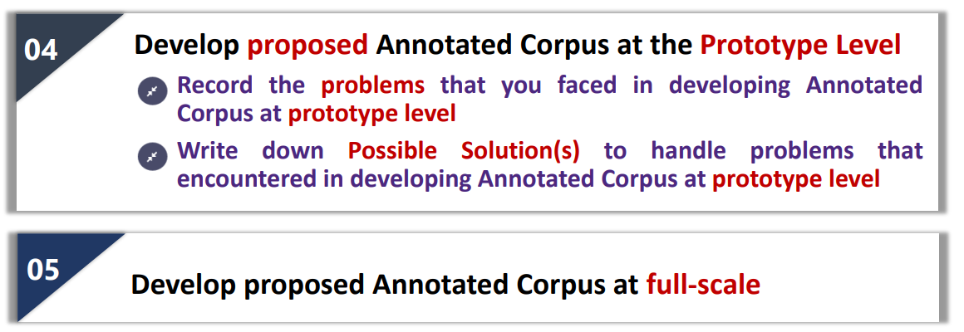
Main Steps for Data Annotation

Slide 7
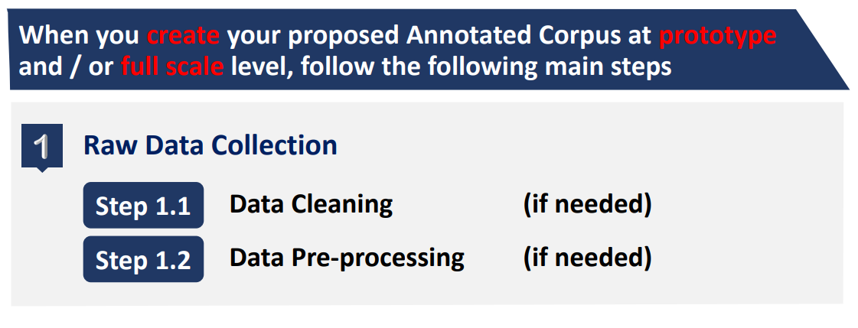
Steps – Annotated Corpus Creation Process

Slide 8
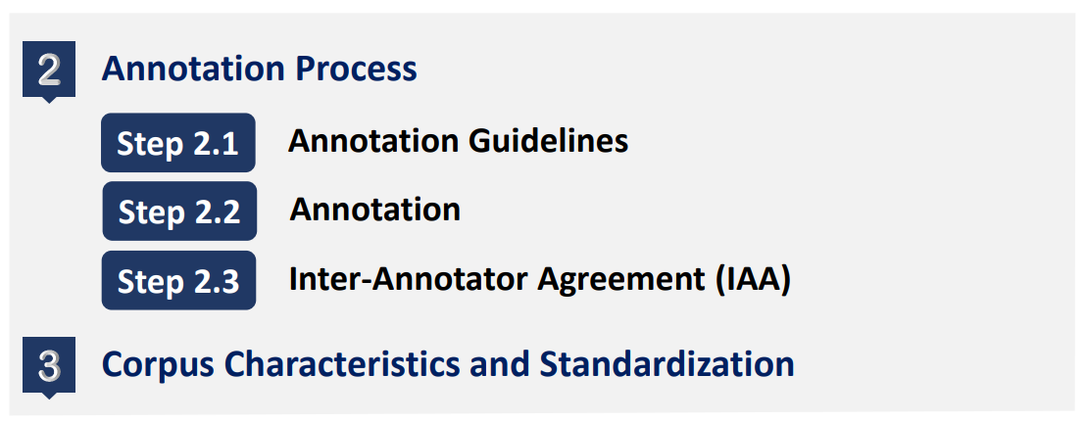
Steps – Annotated Corpus Creation Process

Slide 9
Developing Gold Standard Annotated Corpus using Data Sources with Annotations

Slide 10
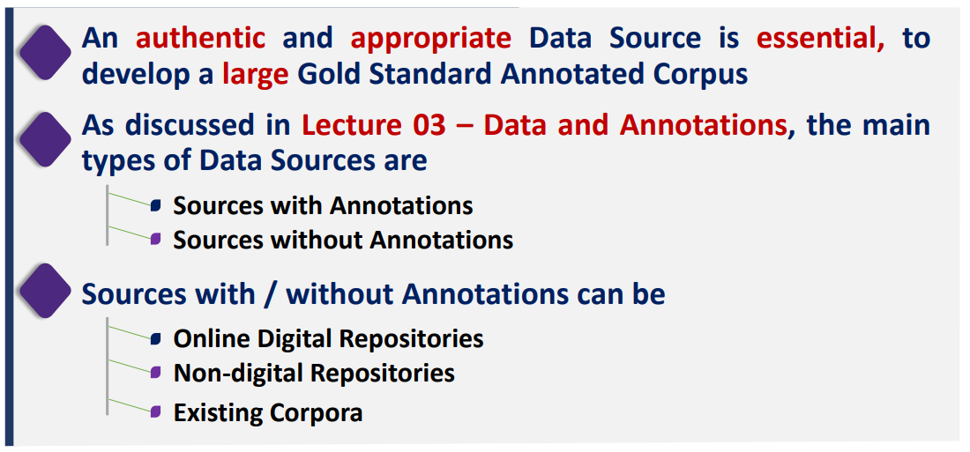
Types of Data Sources

Slide 11
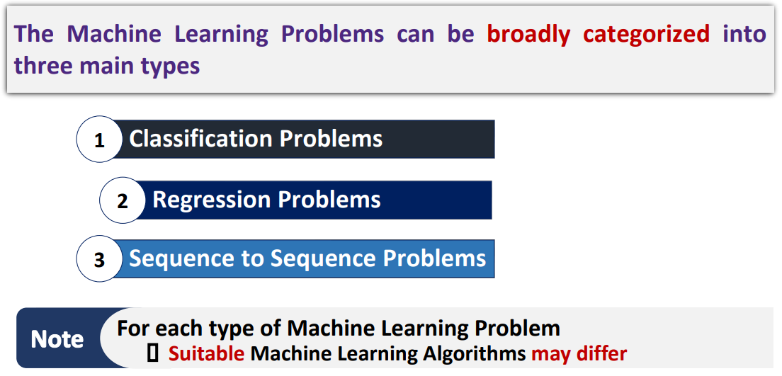
Three Main Types of Machine Learning Problems

Slide 12
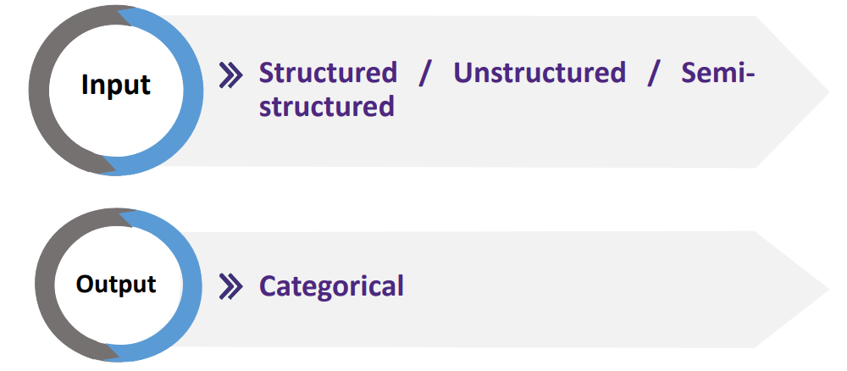
Classification Problems – Input and Output

Slide 13
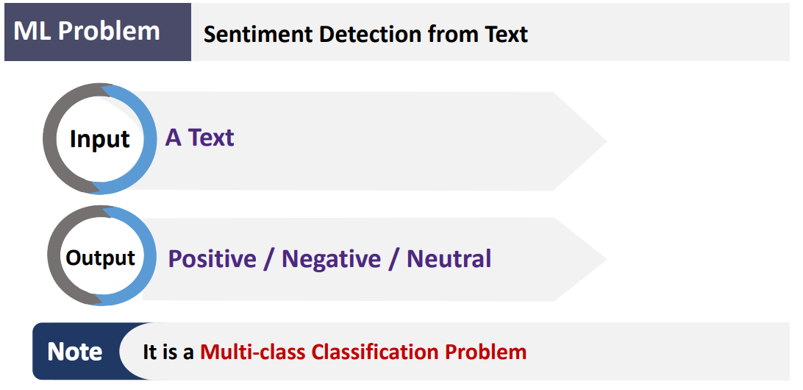
Example 01 - Classification Problems

Slide 14
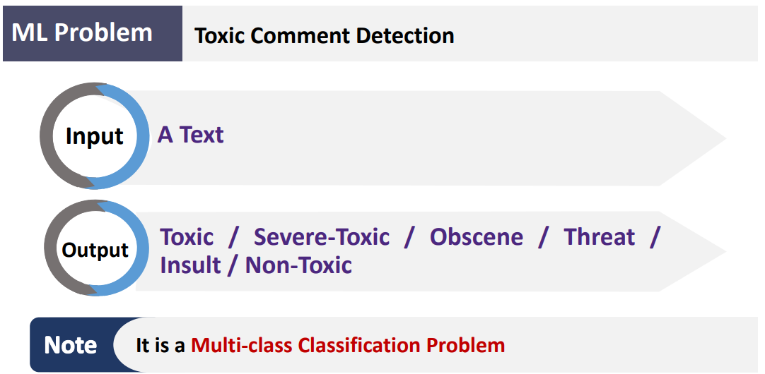
Example 02 - Classification Problems

Slide 15
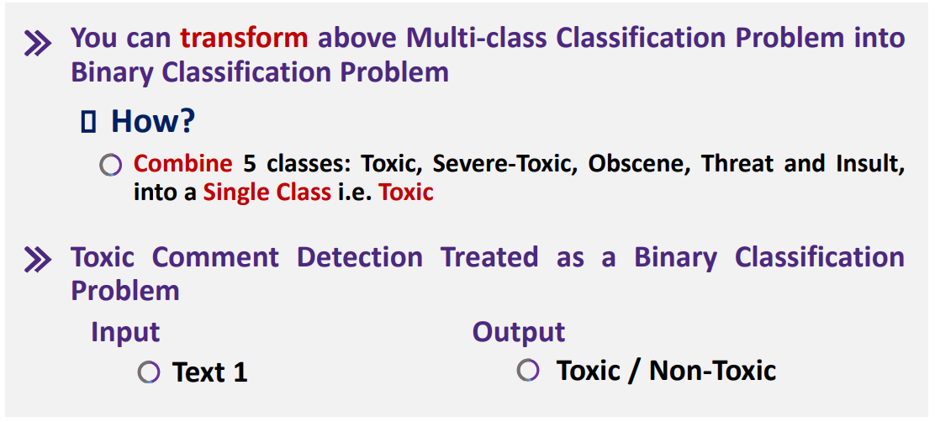
Classification Problem

Slide 16
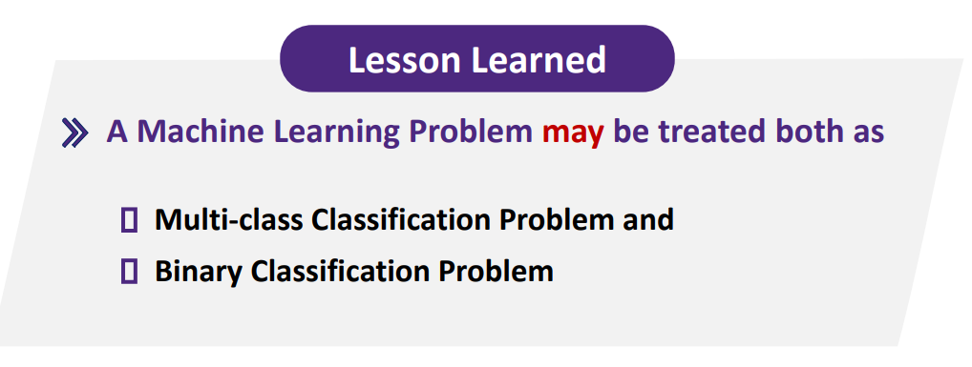
Classification Problem

Slide 17
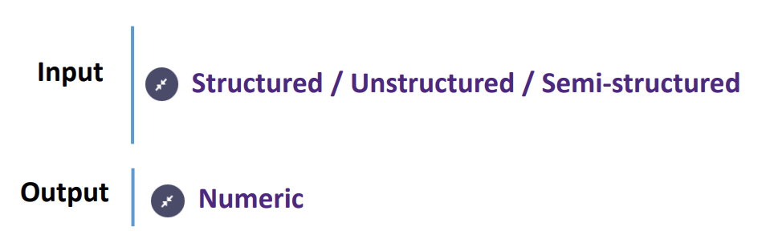
Regression Problems – Input and Output

Slide 18
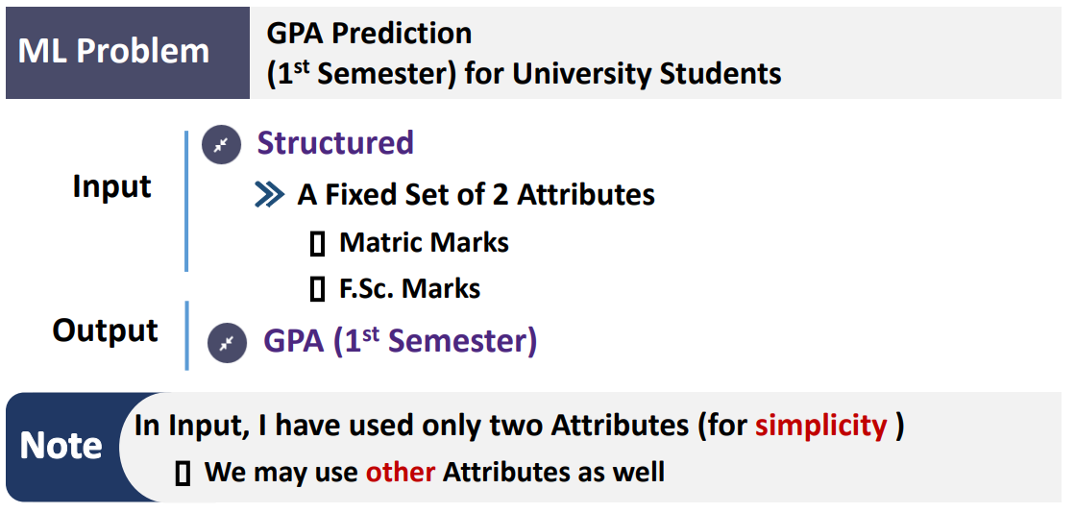
Example 01 - Regression Problems

Slide 19
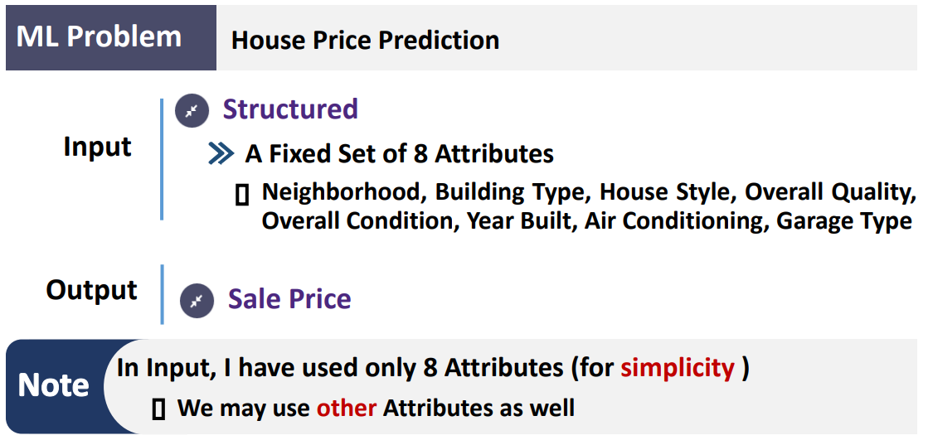
Example 02 - Regression Problems

Slide 20
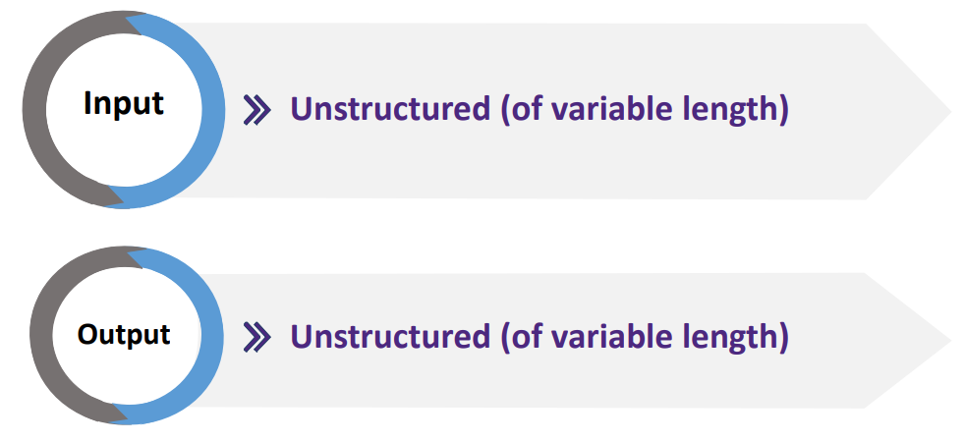
Sequence to Sequence Problems – Input and Output

Slide 21
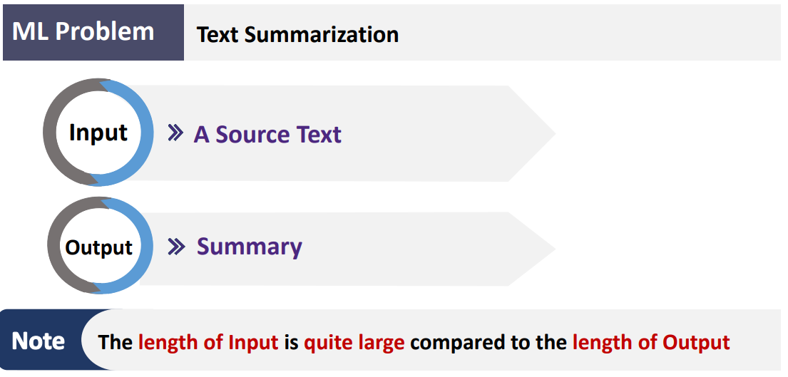
Example 01 - Sequence to Sequence Problems

Slide 22
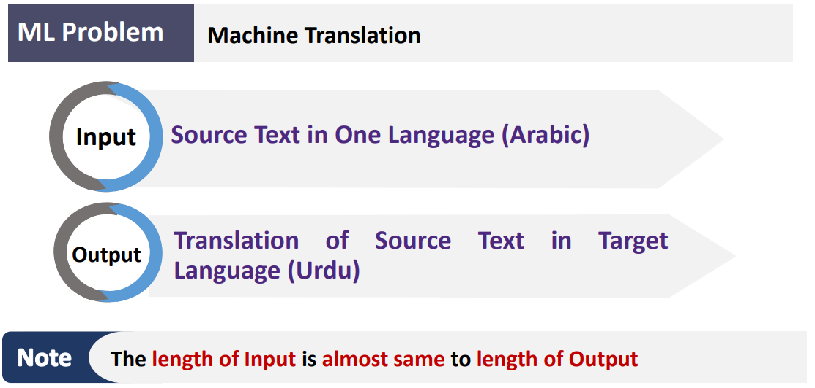
Example 02 - Sequence to Sequence Problems

Slide 23
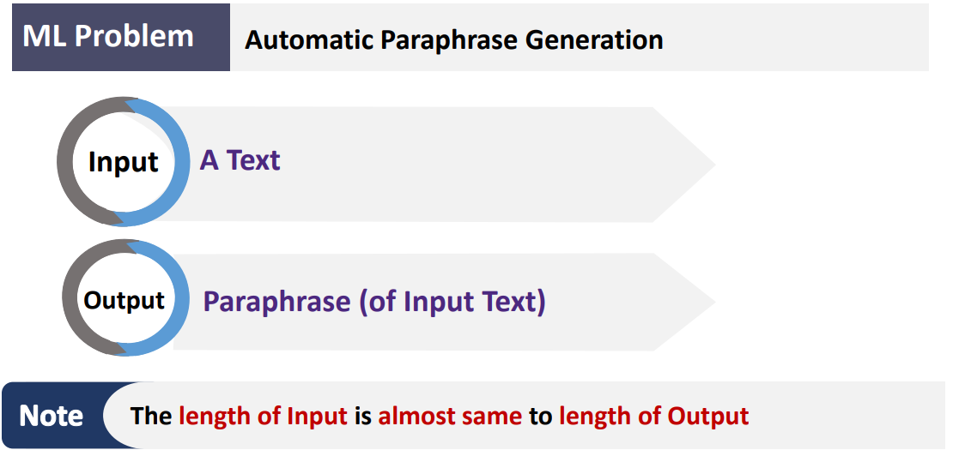
Example 03 - Sequence to Sequence Problems

Slide 24
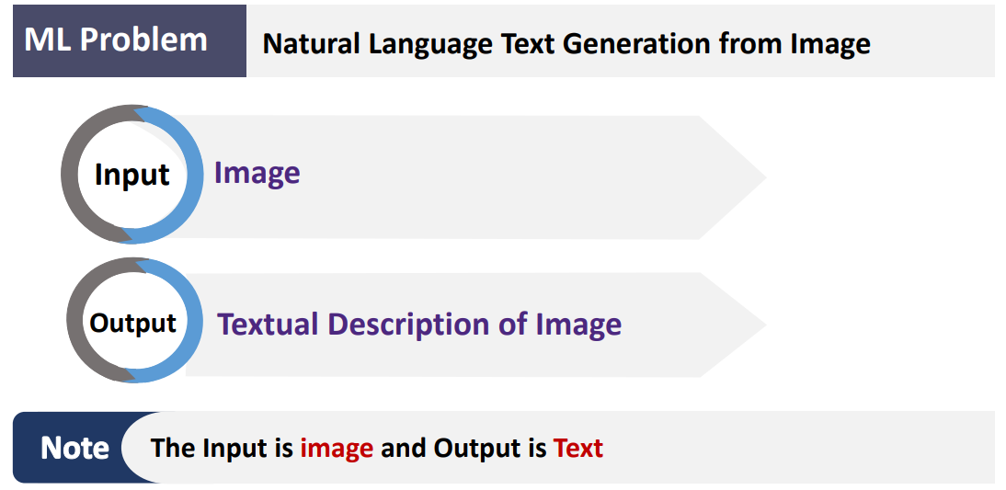
Example 04 - Sequence to Sequence Problems

Slide 25
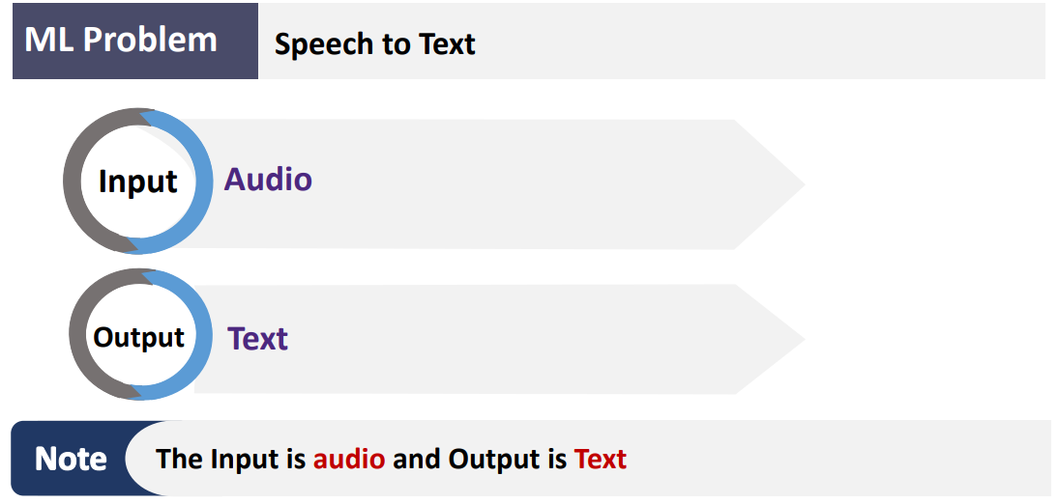
Example 05 - Sequence to Sequence Problems

Slide 26


Slide 27
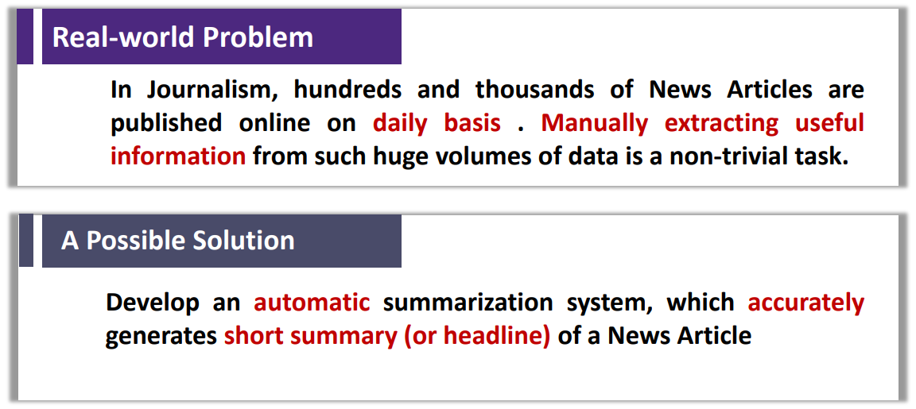
Understanding Real-world Problem

Slide 28


Slide 29
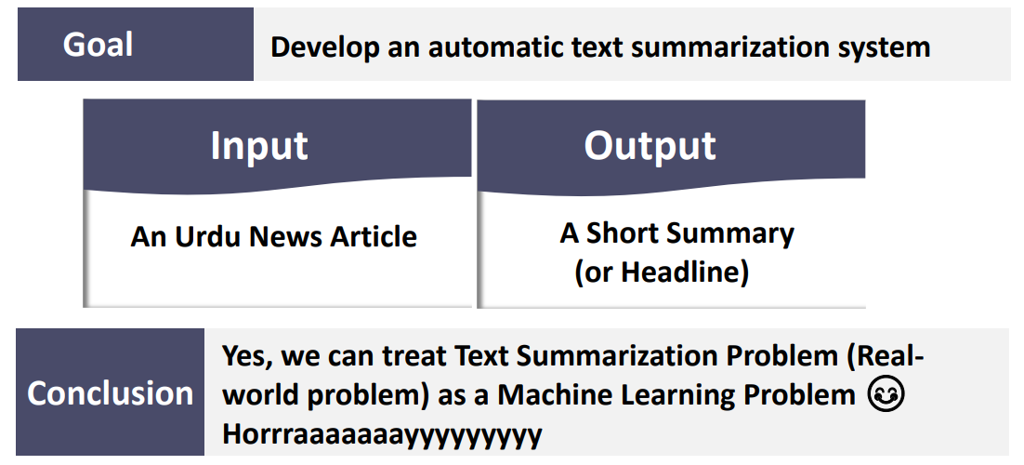
Checking If Real-world Problem Can be Treated as a Machine Learning Problem?

Slide 30
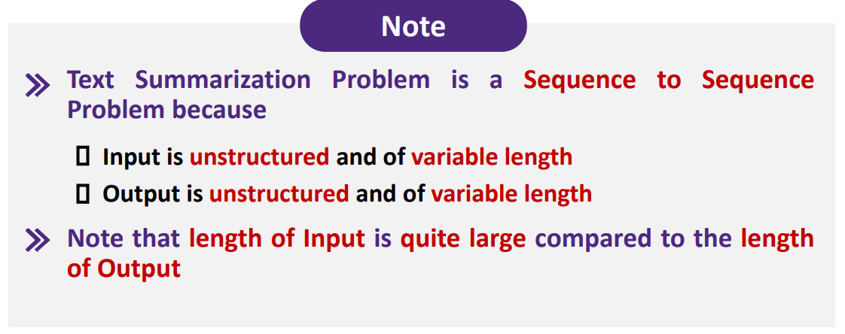
Checking If Real-world Problem Can be Treated as a Machine Learning Problem?

Slide 31
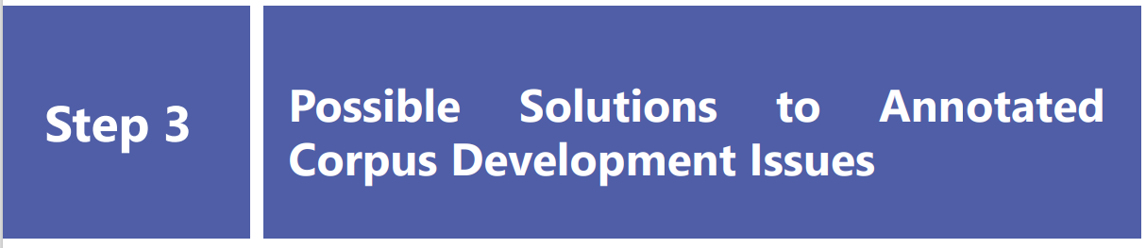

Slide 32

Research Focus and Annotated Corpus Development Issues

Slide 33
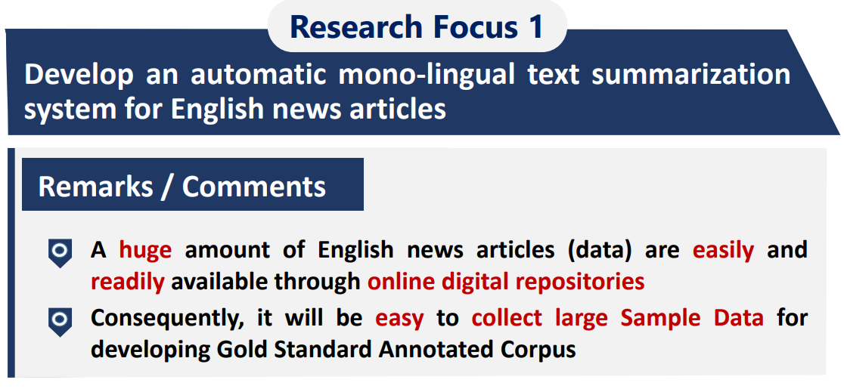
Example – Research Focus

Slide 34
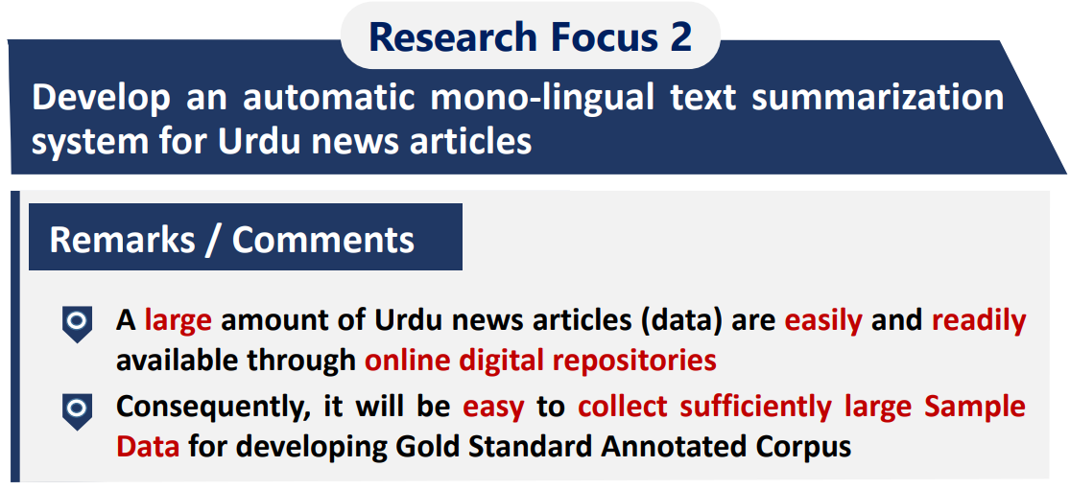
Example – Research Focus

Slide 35
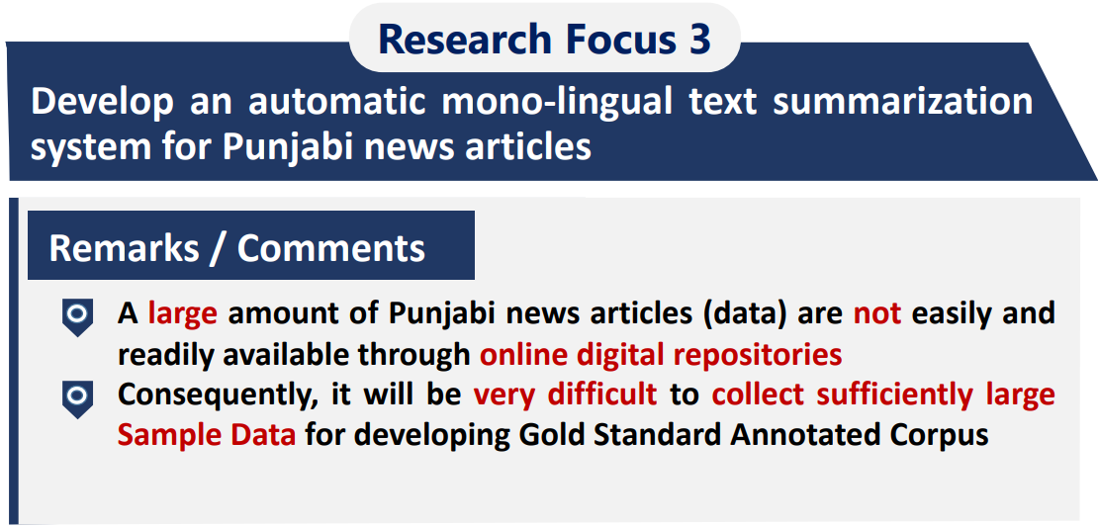
Example – Research Focus

Slide 36
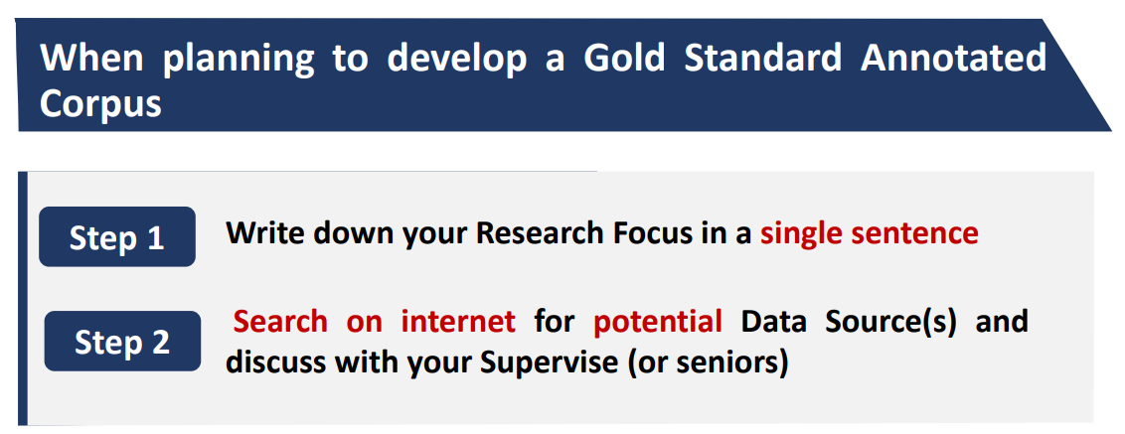
TIP

Slide 37
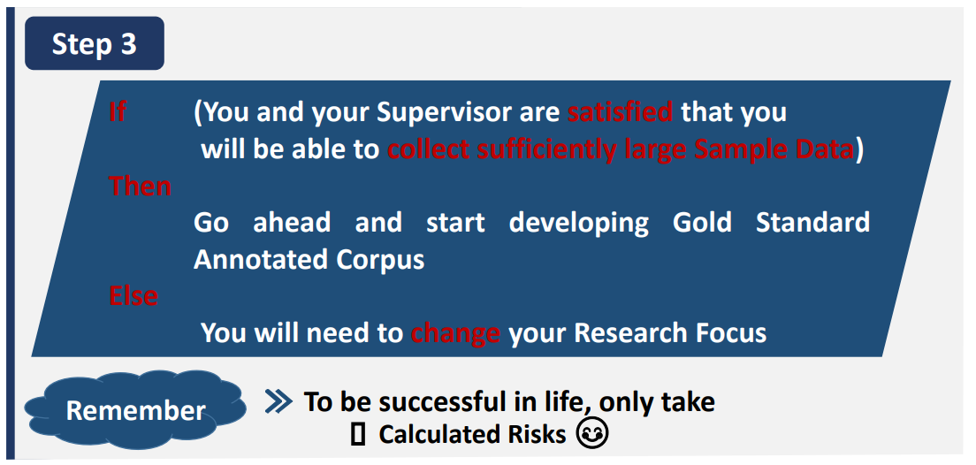
TIP

Slide 38
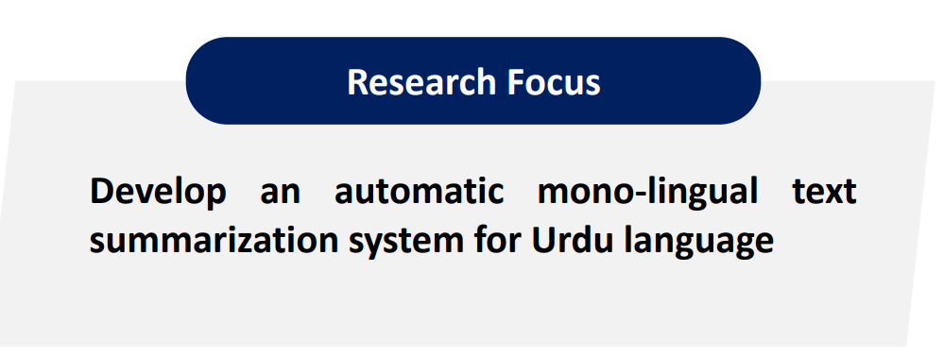
Research Focus for Our Current Example

Slide 39
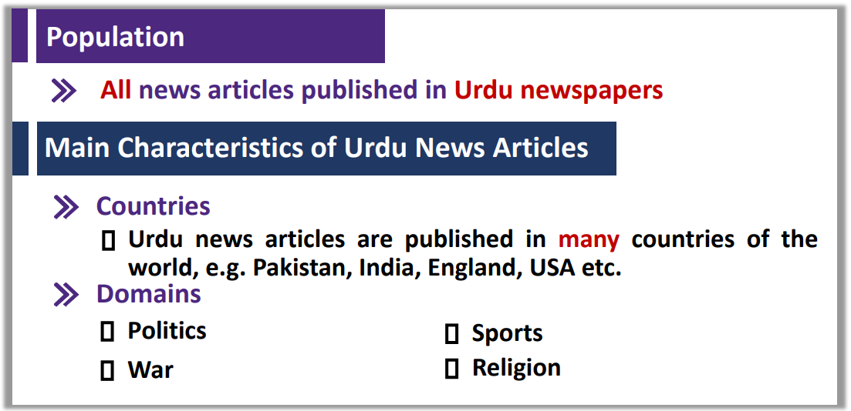
Issue 01 – Data Sampling

Slide 40
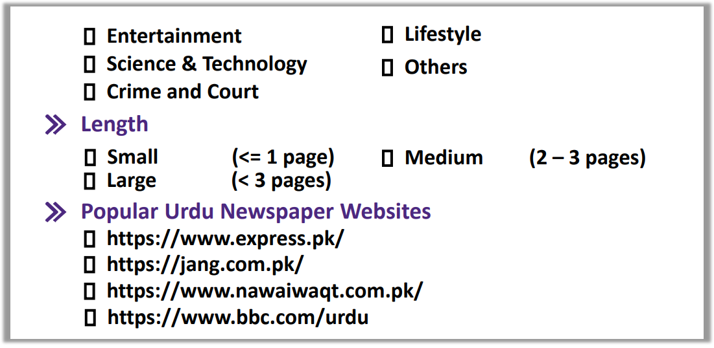
Issue 01 – Data Sampling

Slide 41
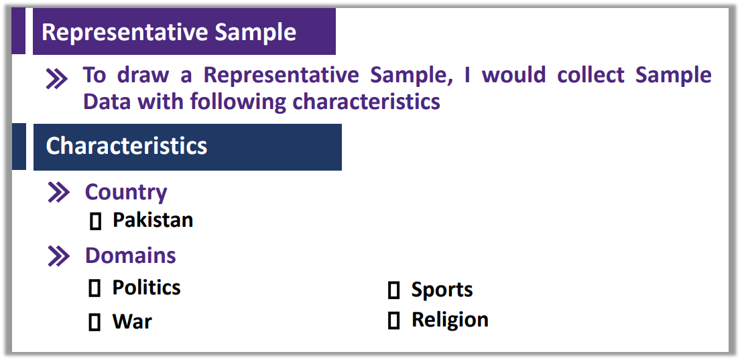
Issue 01 – Data Sampling (Conti.)

Slide 42
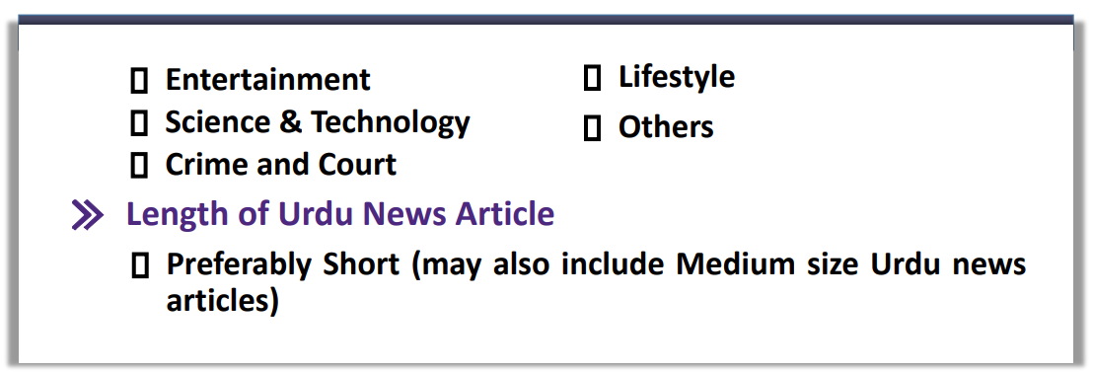
Issue 01 – Data Sampling (Conti.)

Slide 43
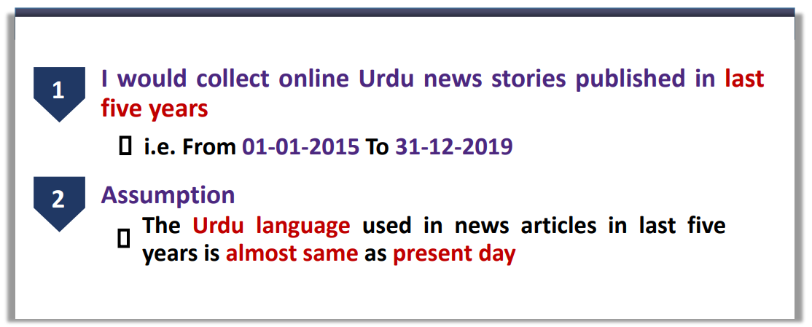
Issue 02 – Time Span

Slide 44
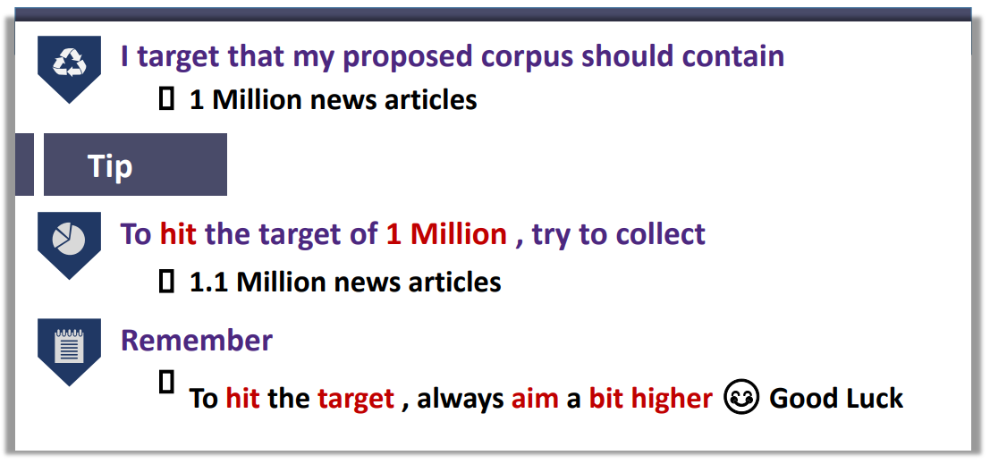
Issue 03 – Size of a Corpus

Slide 45
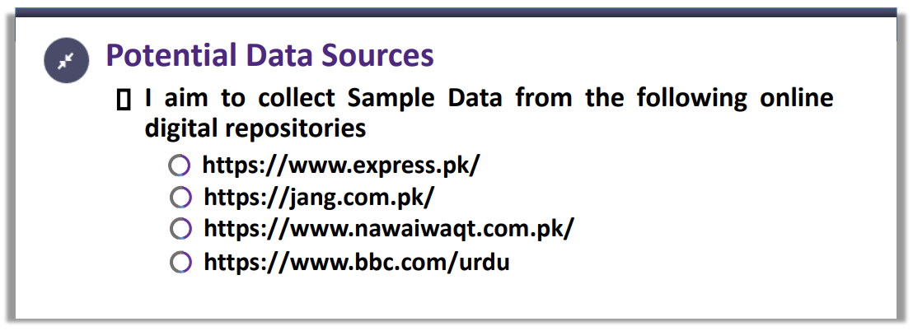
Issue 04 – Potential Data Sources

Slide 46
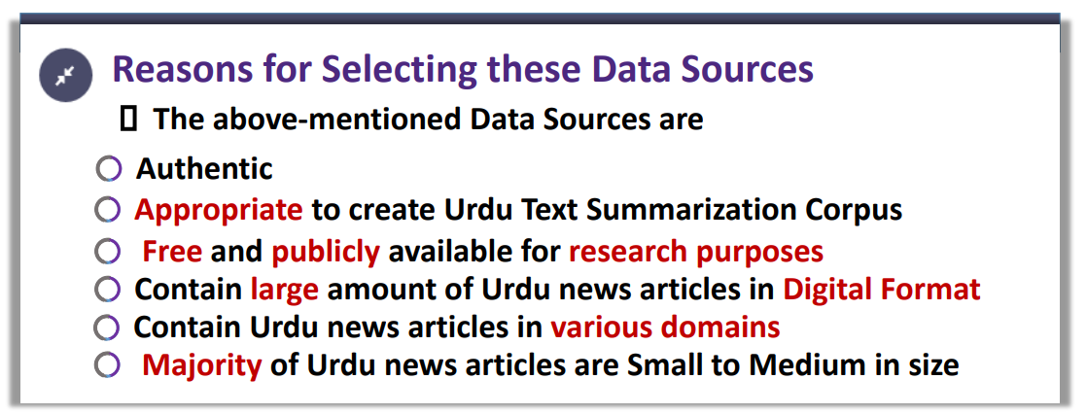
Issue 04 – Potential Data Sources

Slide 47
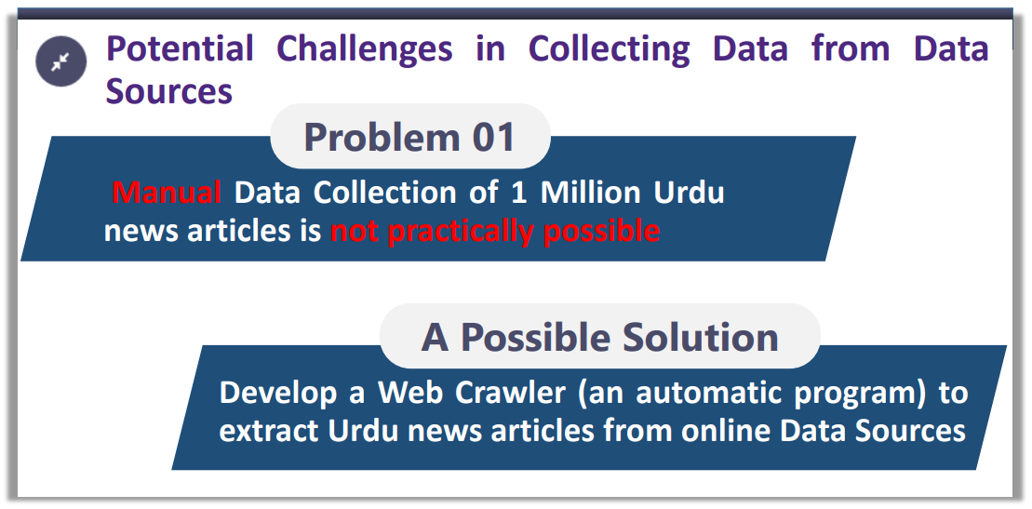
Issue 04 – Potential Data Sources

Slide 48
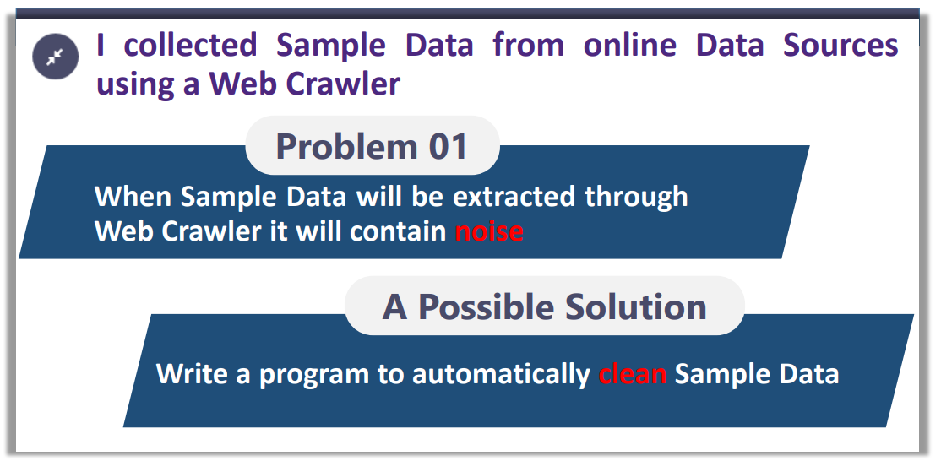
Issue 05 – High Quality Data

Slide 49
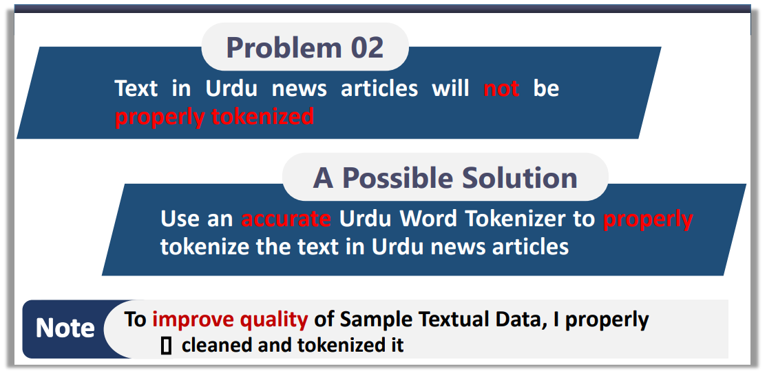
Issue 05 – High Quality Data

Slide 50
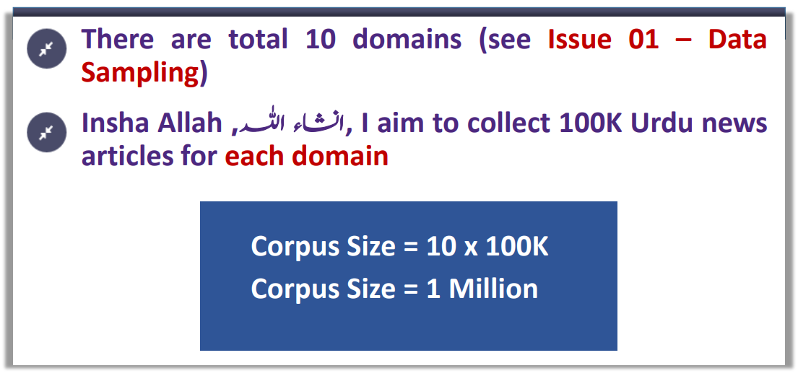
Issue 06 – Balanced Data

Slide 51
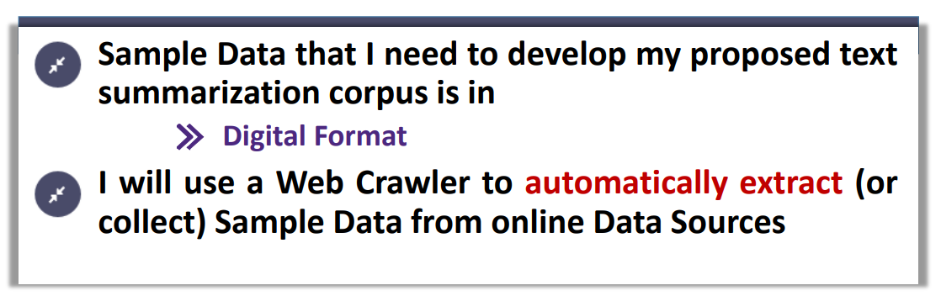
Issue 07 – Data Collection

Slide 52
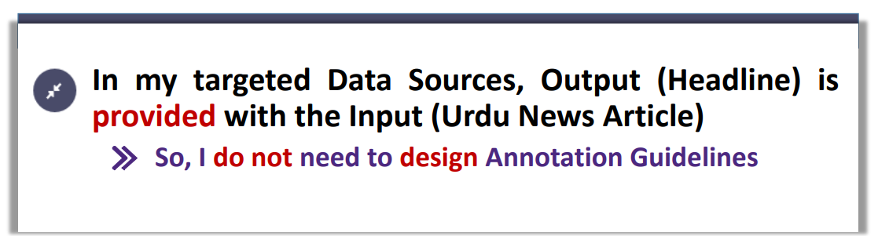
Issue 08 – Annotation Guidelines

Slide 53
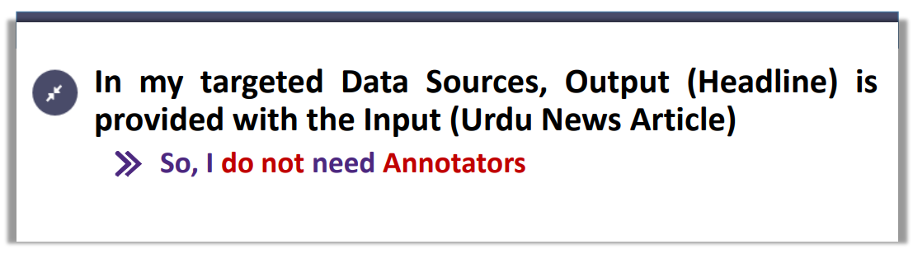
Issue 09 – Annotators

Slide 54
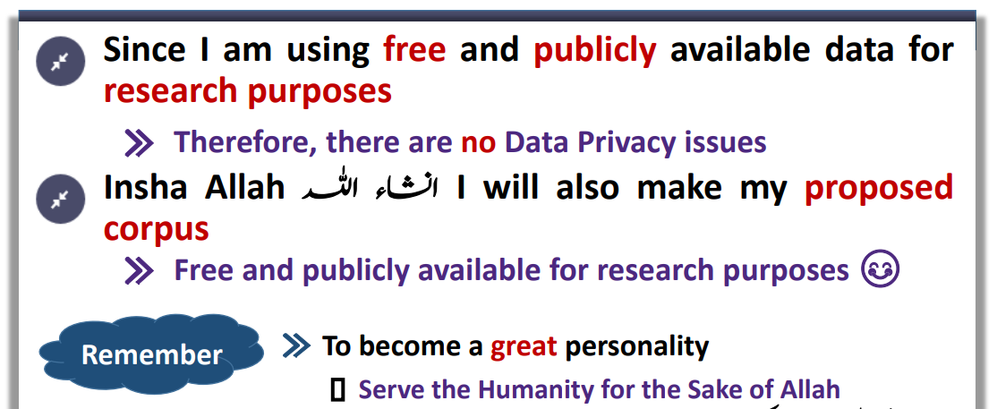
Issue 10 – Data Protection

Slide 55
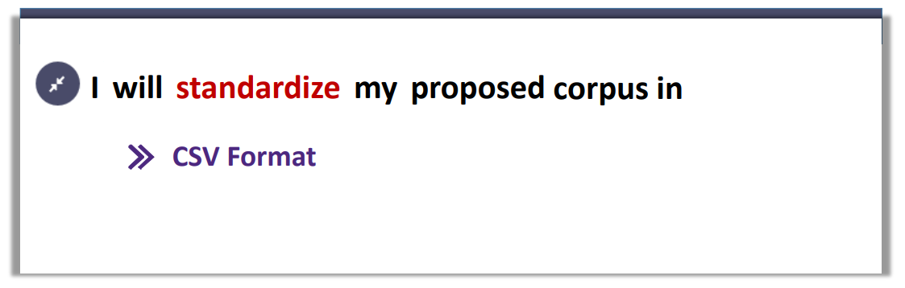
Issue 11 – Corpus Standardization

Slide 56


Slide 57
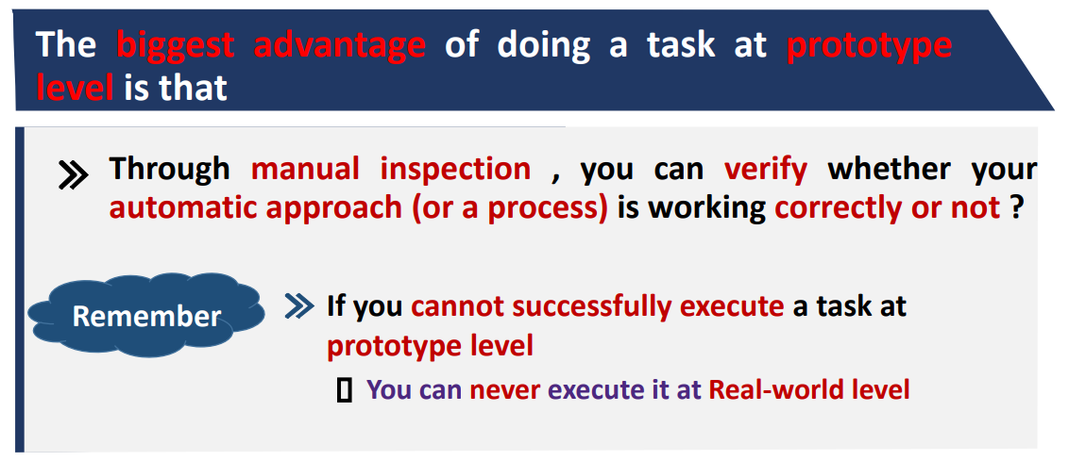
Developing Proposed Annotated Corpus at Prototype Level

Slide 58
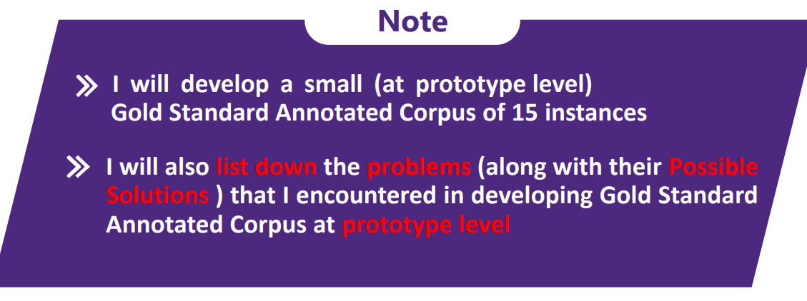
Developing Proposed Annotated Corpus at Prototype Level

Slide 59

Steps – Annotated Corpus Creation Process

Slide 60

Steps – Annotated Corpus Creation Process

Slide 61

Step 1 – Raw Data Collection

Slide 62

Step 1 – Raw Data Collection

Slide 63

Step 1 – Raw Data Collection

Slide 64

Step 2 – Annotation Process

